Slide 1


OTP Verification System
Created by Palak Pastagiya-S8039

Slide 2


Contents
Project overview and scope
Business Problem
Technical Stacks
Project Architecture
GUI Results and Test cases
Project Code
Challenges
Future Scope

Slide 3
Project Introduction
OTP-One Time Password Verification: OTP is a security code which is only valid for one use. OTP verification is used to authenticate users logging into account, network or system. OTPs are used to minimize the risk of fraudulent login attempts. OTP verification system is generated using Python.
.

Slide 4

Project Scope
Implement function to generate 6 digit OTP randomly
Develop a function to simulate sending OTP to user’s email address
Create a function to prompt user to enter OTP received in email
Implement a function to verify if the entered OTP matches the generated OTP
Ensure proper error handling throughout the system
Allow user to retry to OTP entry in case of incorrect input

Slide 5

Business Problem
Generate an OTP verification system in Python. The system should generate a 6 digit OTP and send it to the user’s email address for verification. Upon receiving the OTP, user should enter it to the system for validation. If the entered OTP matches the generated OTP, access should be granted otherwise access should be denied.

Slide 6




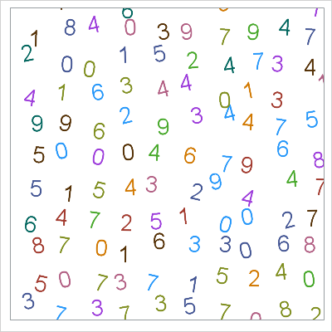

Technical Stacks
Python:
Programming language
Tkinter:
Python interface to Tcl/Tk GUI toolkit
Jupyter Notebook:
IDE
SMTP:
Simple Mail
Transfer Protocol
Random:
Generate pseudo random number
Timer

Slide 7
Send Email using SMTP server
SMTP (Simple Mail Transfer Protocol).
Import the necessary modules: smtplib, MIMEMultipart, and MIMEText.
Define sender and receiver email addresses, along with the email subject and body.
Use MIMEMultipart to create a multipart message, allowing for multiple parts (e.g., text, attachments).
Set the sender, receiver, and subject fields of the email.
Attach the body text using MIMEText.
Establish a connection to the SMTP server using smtplib.SMTP.
Optionally, start TLS encryption for secure communication with server.starttls().
Login to the SMTP server using your email credentials with server.login().
Convert the message into string
Server.sendmail() to send the email, specifying sender , receiver and email content

Slide 8
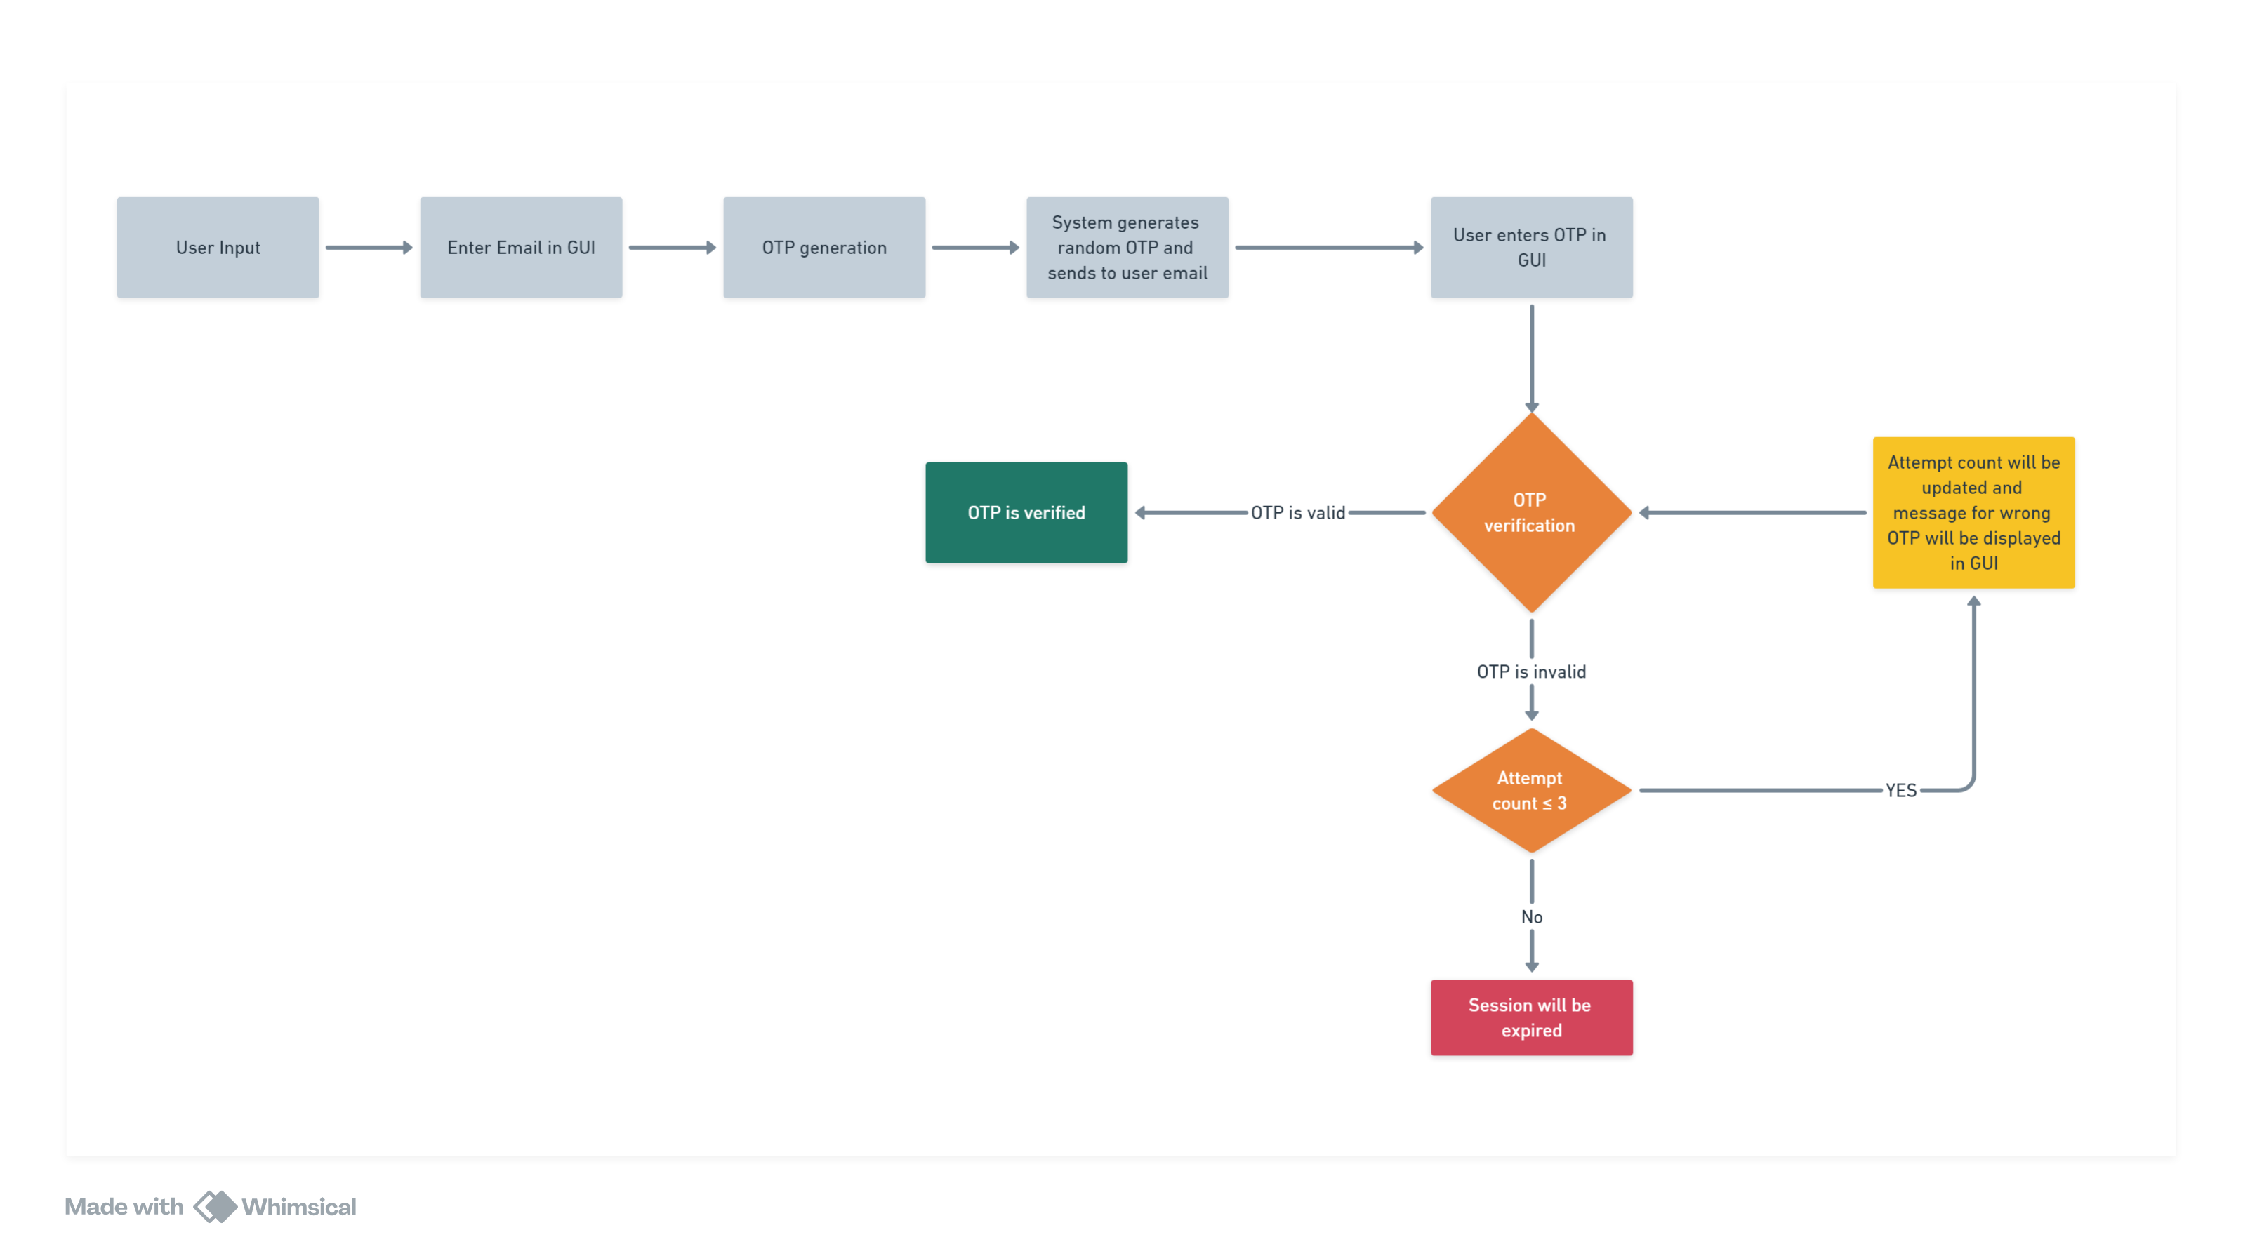
Project Architecture

Slide 9
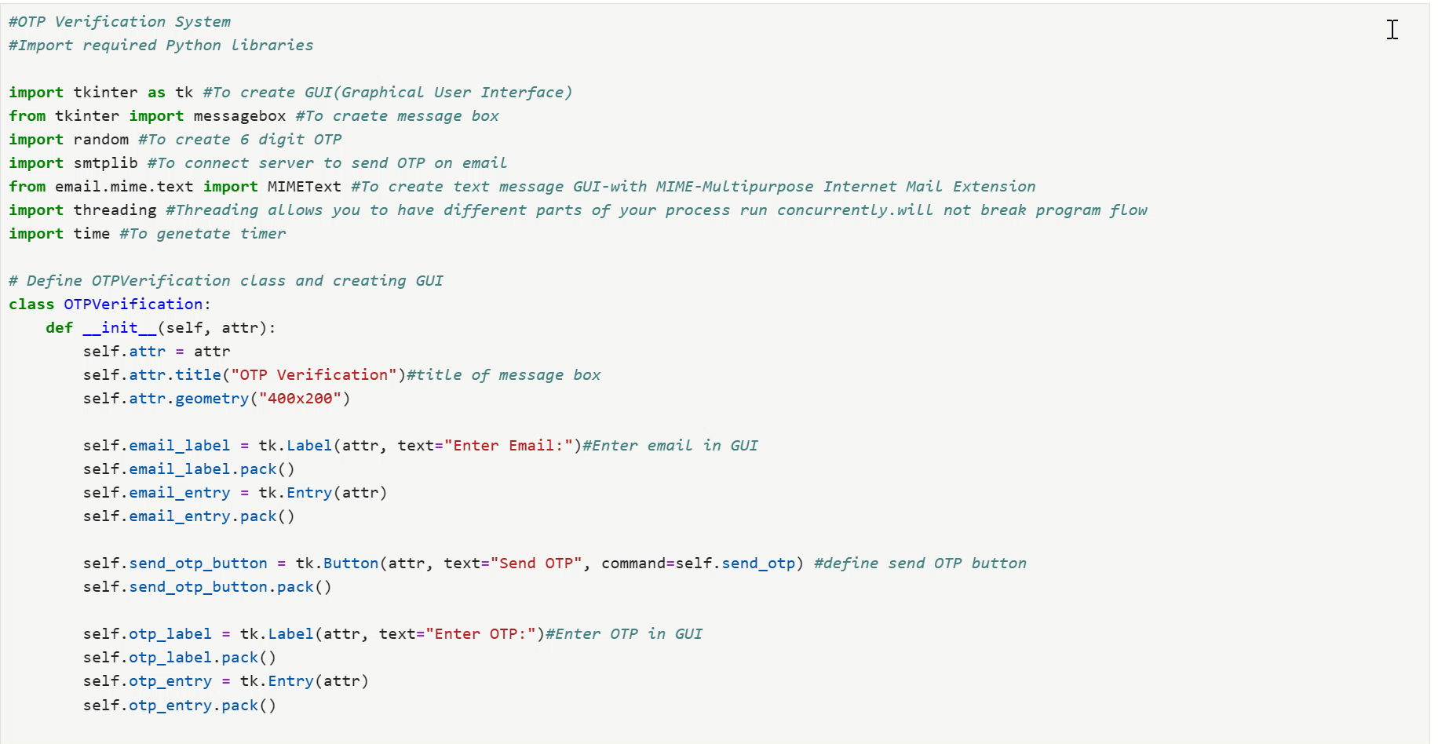
Project Code

Slide 10
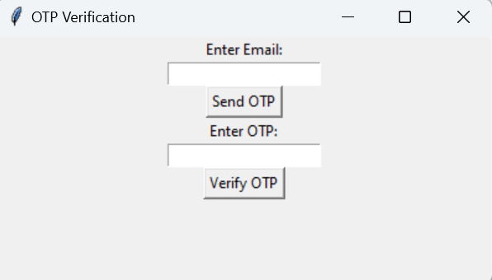
GUI Results and Test cases

Slide 11
Challenges
Security
Email delivery reliability
User Experience
Scalability

Slide 12
Future scope
In this OTP verification system we can enhance security with other authentication factors such as Biometric Integration, AI driven Authentication ,mobile authentication app to provide stronger user authentication.

Slide 13
Thank You

